Slide 1

Welcome to the
Introduction to Software Engineering
The session will start shortly…
Questions? Drop them in the chat. We'll have dedicated moderators answering questions.

Slide 2

Cyber Security Session Housekeeping
The use of disrespectful language is prohibited in the questions, this is a supportive, learning environment for all - please engage accordingly. (Fundamental British Values: Mutual Respect and Tolerance)
No question is daft or silly - ask them!
There are Q&A sessions midway and at the end of the session, should you wish to ask any follow-up questions. Moderators are going to be answering questions as the session progresses as well.
If you have any questions outside of this lecture, or that are not answered during this lecture, please do submit these for upcoming Academic Sessions. You can submit these questions here: Questions

Slide 3
Cyber Security Session Housekeeping cont.
For all non-academic questions, please submit a query: www.hyperiondev.com/support
We would love your feedback on lectures: Feedback on Lectures
If you are hearing impaired, please kindly enable captions on Google chrome/Microsoft Edge via the accessibility settings.

Slide 4
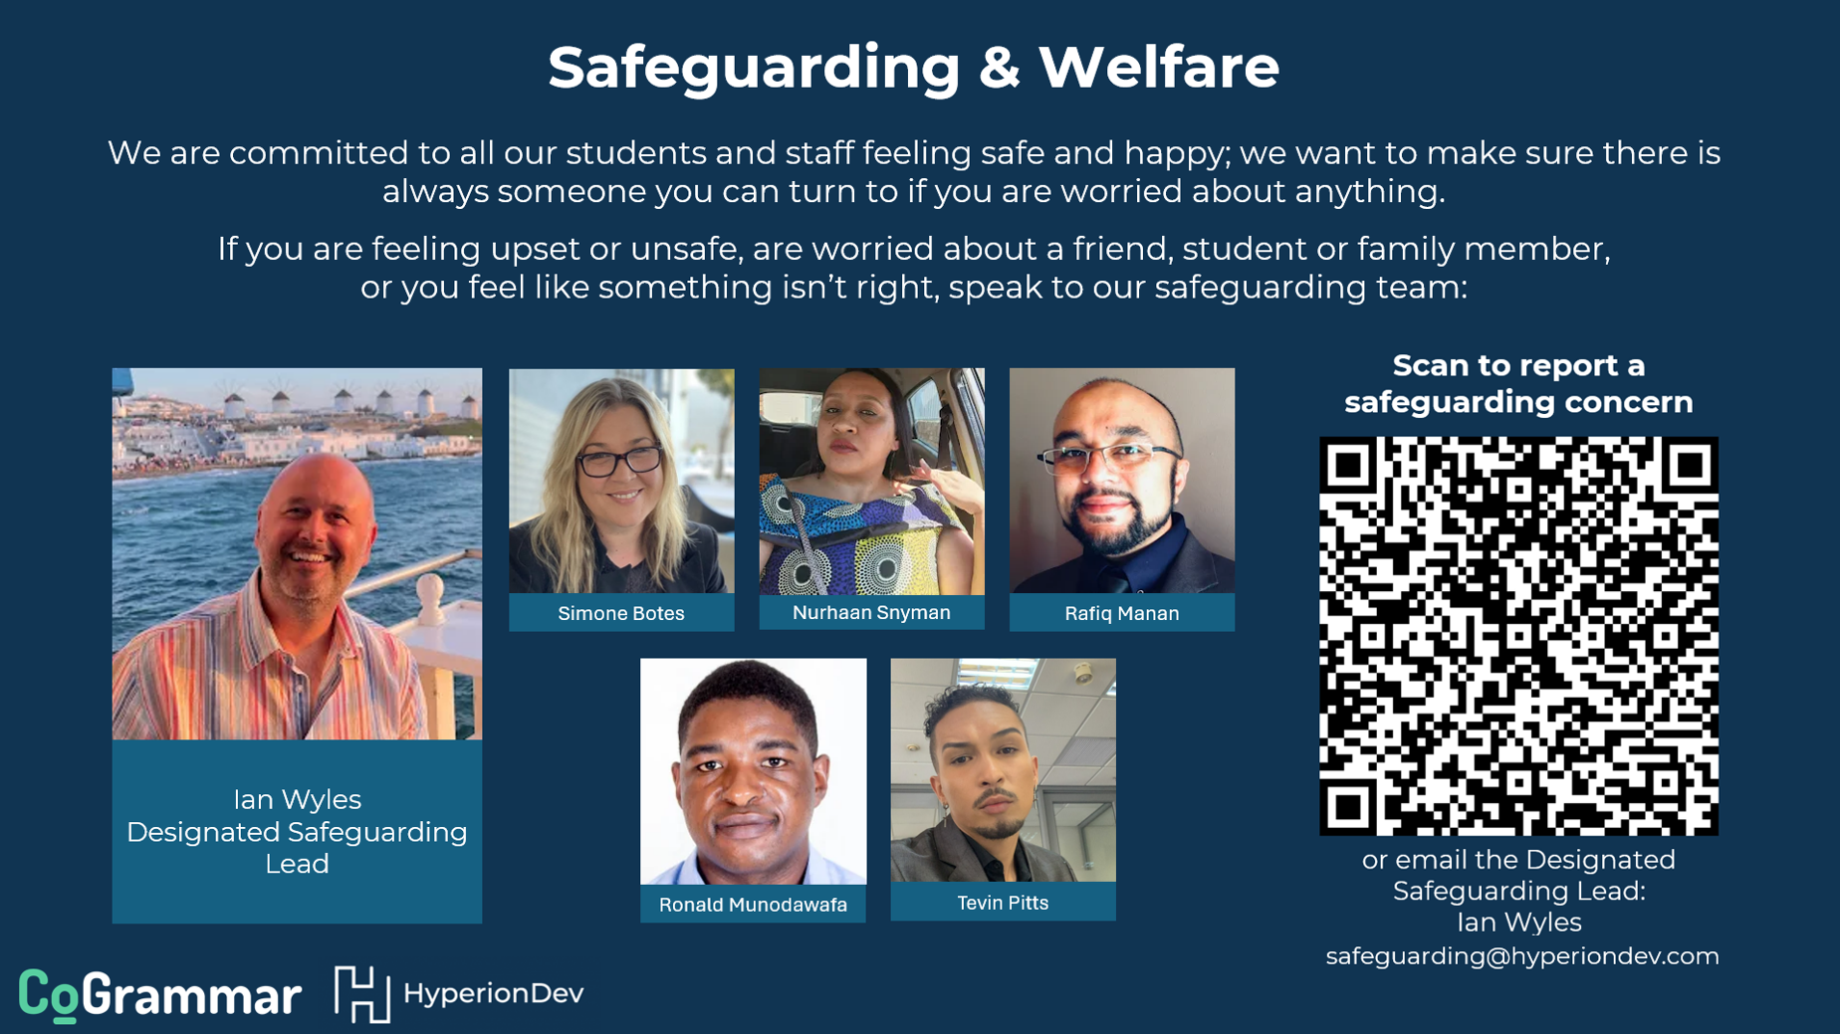

Slide 5

Stay Safe Series:
Mastering Online Safety One Week/step at a Time
While the digital world can be a wonderful place to make education and learning accessible to all, it is unfortunately also a space where harmful threats like online radicalisation, extremist propaganda, phishing scams, online blackmail and hackers can flourish.
As a component of this BootCamp the Stay Safe Series will/is designed to guide you through essential measures in order to protect yourself & your community from online dangers, whether they target your privacy, personal information or even attempt to manipulate your beliefs.
Stay Safe Series

Slide 6


Trustworthy Websites: How to Spot Secure Sites
Look for the padlock.
Check if there is a valid SSL/TLS certificate.
Look for a site seal.
Check if the URL is legitimate.
Pop-up and Redirection ads are a red flag.
Stay Safe Series

Slide 7


Learning Objectives & Outcomes
Explain software engineering is and its importance.
Identify the key attributes of good software.
Differentiate between software engineering and programming.
Explain the roles and responsibilities of software engineers.
Discuss the various application areas of software engineering.
Notes:
Mention moderators and Questions tab. Our agenda includes an introduction to CoGrammar, details about student success support, graduation criteria, guided learning hours, learning tools and platforms, an overview of the Skills Bootcamp, and career services.

Slide 8


Introduction to Software Engineering
October 2024
Notes:
Welcome to the Grammar Skills Bootcamp Orientation for November 2023. Today, we will cover several important aspects of this program to ensure you have all the information needed for a successful learning experience.

Slide 9

Strings, Lists and Functions
What do you think software engineering involves?
Notes:
Mention moderators and Questions tab. Our agenda includes an introduction to CoGrammar, details about student success support, graduation criteria, guided learning hours, learning tools and platforms, an overview of the Skills Bootcamp, and career services.

Slide 10

Strings, Lists and Functions
Have you ever written or debugged code?
Notes:
Mention moderators and Questions tab. Our agenda includes an introduction to CoGrammar, details about student success support, graduation criteria, guided learning hours, learning tools and platforms, an overview of the Skills Bootcamp, and career services.

Slide 11

Software Engineering
Systematic approach to designing, developing, maintaining, and managing software.
Solving real-world problems using
technology.
Notes:
Mention moderators and Questions tab. Our agenda includes an introduction to CoGrammar, details about student success support, graduation criteria, guided learning hours, learning tools and platforms, an overview of the Skills Bootcamp, and career services.

Slide 12

Software Engineering
Software engineering vs. programming:
Programming focuses on writing code
Software engineering involves broader activities like requirements, design, and testing.
Notes:
Mention moderators and Questions tab. Our agenda includes an introduction to CoGrammar, details about student success support, graduation criteria, guided learning hours, learning tools and platforms, an overview of the Skills Bootcamp, and career services.

Slide 13





Software Engineering
Notes:
Mention moderators and Questions tab. Our agenda includes an introduction to CoGrammar, details about student success support, graduation criteria, guided learning hours, learning tools and platforms, an overview of the Skills Bootcamp, and career services.

Slide 14
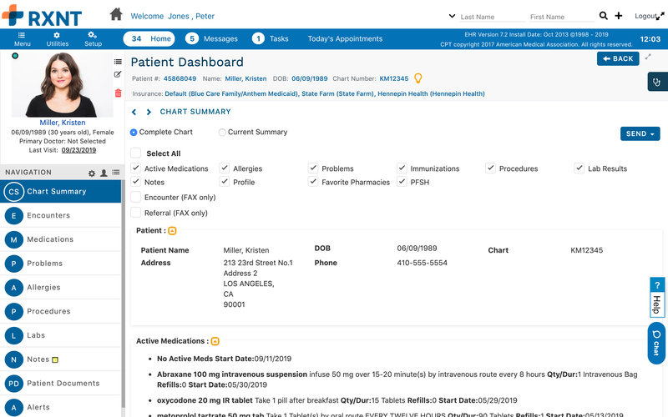
Software Engineering
Notes:
Mention moderators and Questions tab. Our agenda includes an introduction to CoGrammar, details about student success support, graduation criteria, guided learning hours, learning tools and platforms, an overview of the Skills Bootcamp, and career services.

Slide 15






Software Engineering
Notes:
Mention moderators and Questions tab. Our agenda includes an introduction to CoGrammar, details about student success support, graduation criteria, guided learning hours, learning tools and platforms, an overview of the Skills Bootcamp, and career services.

Slide 16

Attributes of Good Software
Functionality
Does the software meet all the requirements?
Notes:
Mention moderators and Questions tab. Our agenda includes an introduction to CoGrammar, details about student success support, graduation criteria, guided learning hours, learning tools and platforms, an overview of the Skills Bootcamp, and career services.

Slide 17

Attributes of Good Software
Reliability
How does the system perform under specified conditions?
Notes:
Mention moderators and Questions tab. Our agenda includes an introduction to CoGrammar, details about student success support, graduation criteria, guided learning hours, learning tools and platforms, an overview of the Skills Bootcamp, and career services.

Slide 18

Attributes of Good Software
Usability
How user-friendly is our software?
Notes:
Mention moderators and Questions tab. Our agenda includes an introduction to CoGrammar, details about student success support, graduation criteria, guided learning hours, learning tools and platforms, an overview of the Skills Bootcamp, and career services.

Slide 19

Attributes of Good Software
Maintainability
How easy is our software to update and fix?
Notes:
Mention moderators and Questions tab. Our agenda includes an introduction to CoGrammar, details about student success support, graduation criteria, guided learning hours, learning tools and platforms, an overview of the Skills Bootcamp, and career services.

Slide 20

Attributes of Good Software
Efficiency
How efficiently does our software use resources?
Notes:
Mention moderators and Questions tab. Our agenda includes an introduction to CoGrammar, details about student success support, graduation criteria, guided learning hours, learning tools and platforms, an overview of the Skills Bootcamp, and career services.

Slide 21

Attributes of Good Software
Think of some of the software that you use daily.
Can you see some of these qualities/attributes in the software?
Notes:
Mention moderators and Questions tab. Our agenda includes an introduction to CoGrammar, details about student success support, graduation criteria, guided learning hours, learning tools and platforms, an overview of the Skills Bootcamp, and career services.

Slide 22
Roles
Software Developer
Designs, writes, and maintains code to create software applications or systems.
Notes:
Mention moderators and Questions tab. Our agenda includes an introduction to CoGrammar, details about student success support, graduation criteria, guided learning hours, learning tools and platforms, an overview of the Skills Bootcamp, and career services.

Slide 23

Roles
Systems Analyst
Evaluates business needs and develops technical solutions to improve processes and systems.
Notes:
Mention moderators and Questions tab. Our agenda includes an introduction to CoGrammar, details about student success support, graduation criteria, guided learning hours, learning tools and platforms, an overview of the Skills Bootcamp, and career services.

Slide 24

Roles
Quality Assurance Engineer
Tests and ensures the software meets quality standards and functions as intended.
Notes:
Mention moderators and Questions tab. Our agenda includes an introduction to CoGrammar, details about student success support, graduation criteria, guided learning hours, learning tools and platforms, an overview of the Skills Bootcamp, and career services.

Slide 25

Roles
DevOps Engineer
Bridges development and operations by automating and streamlining software delivery processes.
Notes:
Mention moderators and Questions tab. Our agenda includes an introduction to CoGrammar, details about student success support, graduation criteria, guided learning hours, learning tools and platforms, an overview of the Skills Bootcamp, and career services.

Slide 26

Roles
Project Manager
Plans, organises, and oversees software projects to ensure they are completed on time, within budget, and meet objectives.
Notes:
Mention moderators and Questions tab. Our agenda includes an introduction to CoGrammar, details about student success support, graduation criteria, guided learning hours, learning tools and platforms, an overview of the Skills Bootcamp, and career services.

Slide 27
Roles
Which role do you find the most interesting?
Software Developer
System Analyst
Quality Assurance Engineer
DevOps Engineer
Project Manager
Notes:
Mention moderators and Questions tab. Our agenda includes an introduction to CoGrammar, details about student success support, graduation criteria, guided learning hours, learning tools and platforms, an overview of the Skills Bootcamp, and career services.

Slide 28
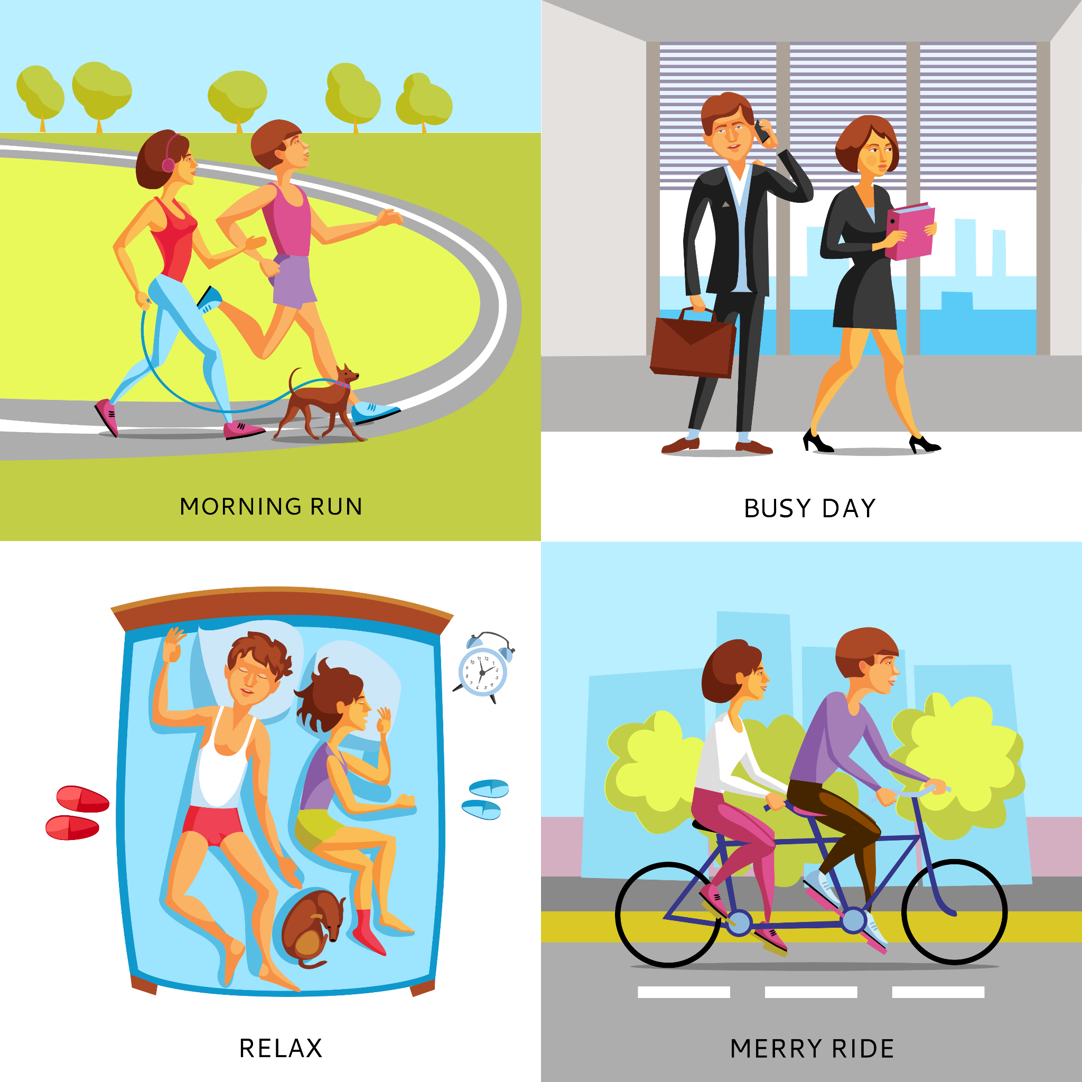
Roles
Where does software engineering play a role in your everyday life?
Notes:
Mention moderators and Questions tab. Our agenda includes an introduction to CoGrammar, details about student success support, graduation criteria, guided learning hours, learning tools and platforms, an overview of the Skills Bootcamp, and career services.

Slide 29
Polls
Please have a look at the poll notification and select an option.
What is the primary goal of software engineering?
Writing as much code as possible
Systematic development of software that meets user needs
Avoiding collaboration with a team
Focusing only on debugging programs
Notes:
Mention moderators and Questions tab. Our agenda includes an introduction to CoGrammar, details about student success support, graduation criteria, guided learning hours, learning tools and platforms, an overview of the Skills Bootcamp, and career services.

Slide 30
Polls
Please have a look at the poll notification and select an option.
Which of the following is NOT a key attribute of good software?
Maintainability
Usability
Inefficiency
Reliability
Notes:
Mention moderators and Questions tab. Our agenda includes an introduction to CoGrammar, details about student success support, graduation criteria, guided learning hours, learning tools and platforms, an overview of the Skills Bootcamp, and career services.

Slide 31
Polls
Please have a look at the poll notification and select an option.
Which of these is an example of software engineering in healthcare?
Writing prescriptions
Designing a patient record management system
Treating patients
Building hospital infrastructure
Notes:
Mention moderators and Questions tab. Our agenda includes an introduction to CoGrammar, details about student success support, graduation criteria, guided learning hours, learning tools and platforms, an overview of the Skills Bootcamp, and career services.

Slide 32
Recap
Software plays a large part in everyday life with software being used in all industries including medical, financial, entertainment, transport, etc.
Software needs to be reliable and efficient.
Notes:
Mention moderators and Questions tab. Our agenda includes an introduction to CoGrammar, details about student success support, graduation criteria, guided learning hours, learning tools and platforms, an overview of the Skills Bootcamp, and career services.

Slide 33
Questions and
Answers

Slide 34

Thank you for attending

